Slide 1
Right now there is a virus that is making people sick

Slide 2
This means we have to stay in our houses, and find things to do at home!

Slide 3
To keep people safe, work and businesses are closed

Slide 4
Right now we don’t know when things will reopen

Slide 5
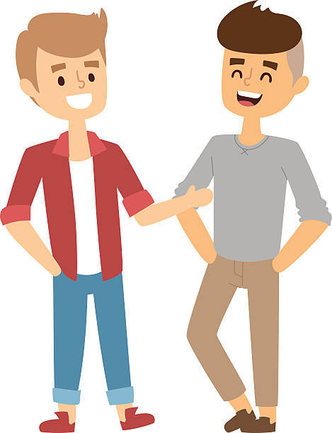
I miss coming to work and seeing my friends

Slide 6
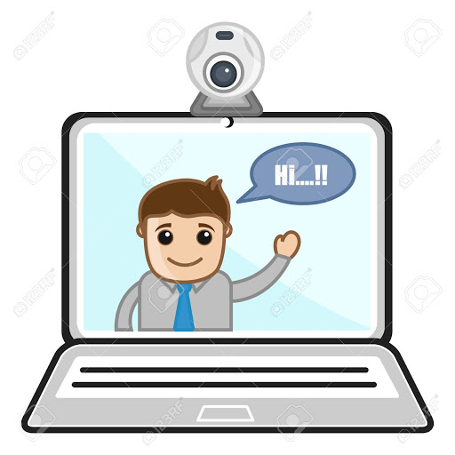
But I can video chat with them, and hang out over the internet

Slide 7
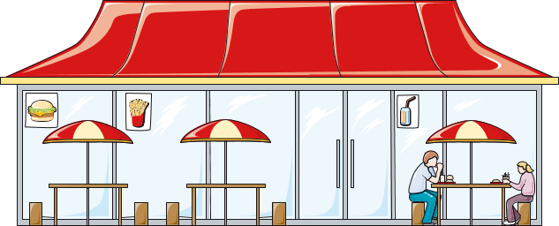
I love to eat out at restaurants

Slide 8
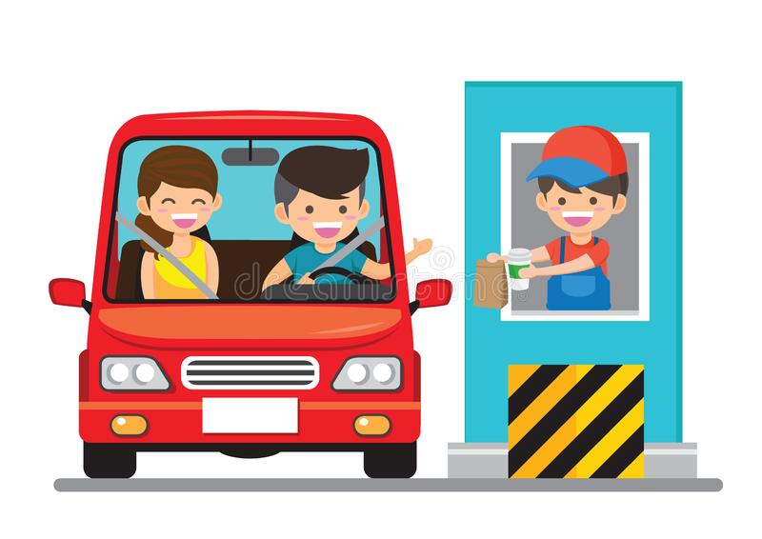
All the restaurants are closed, so I have to go through the drive thru and eat at home

Slide 9
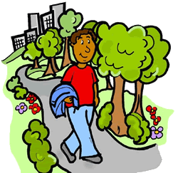
Our leaders will tell us when it’s safe to go out

