Slide 1
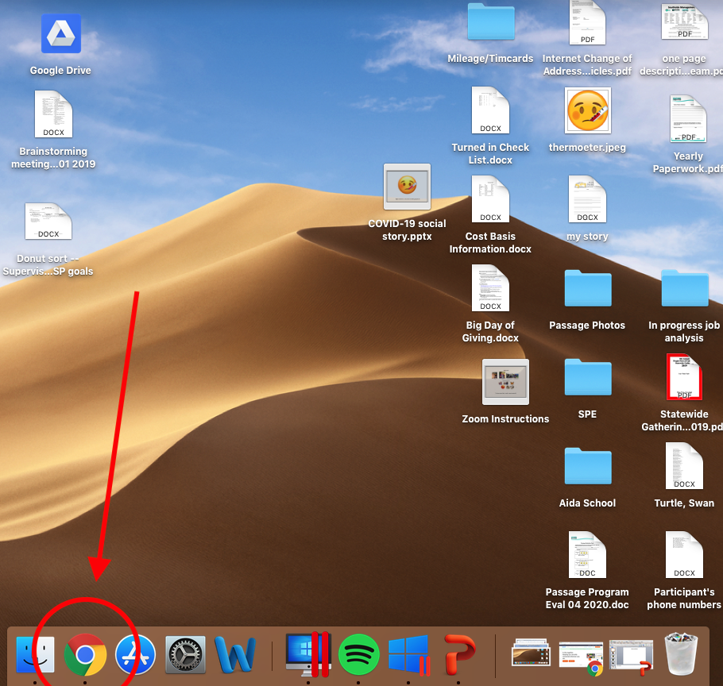
Open your web browser

Slide 2
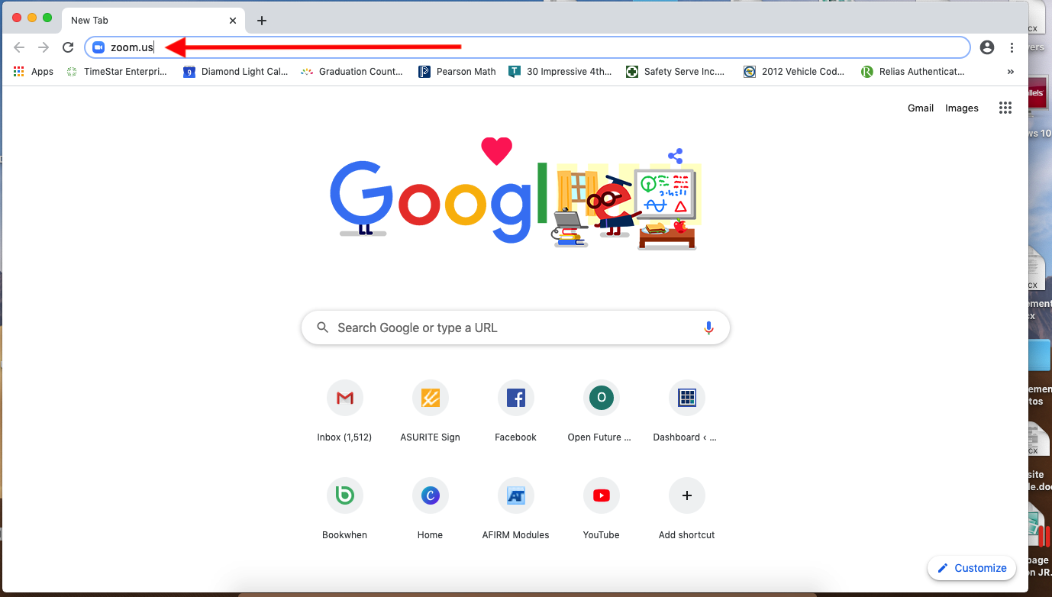
In the search bar, type in zoom.us Hit “enter” on your keyboard

Slide 3
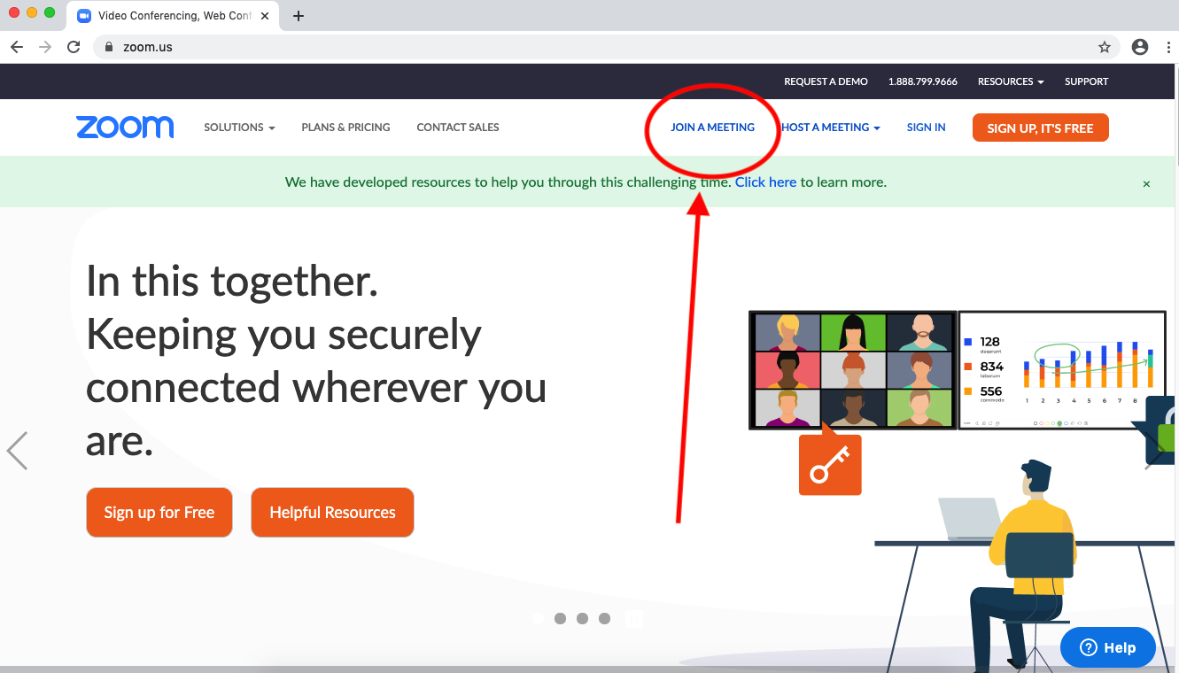
Click “Join a Meeting” on the top right menu bar

Slide 4
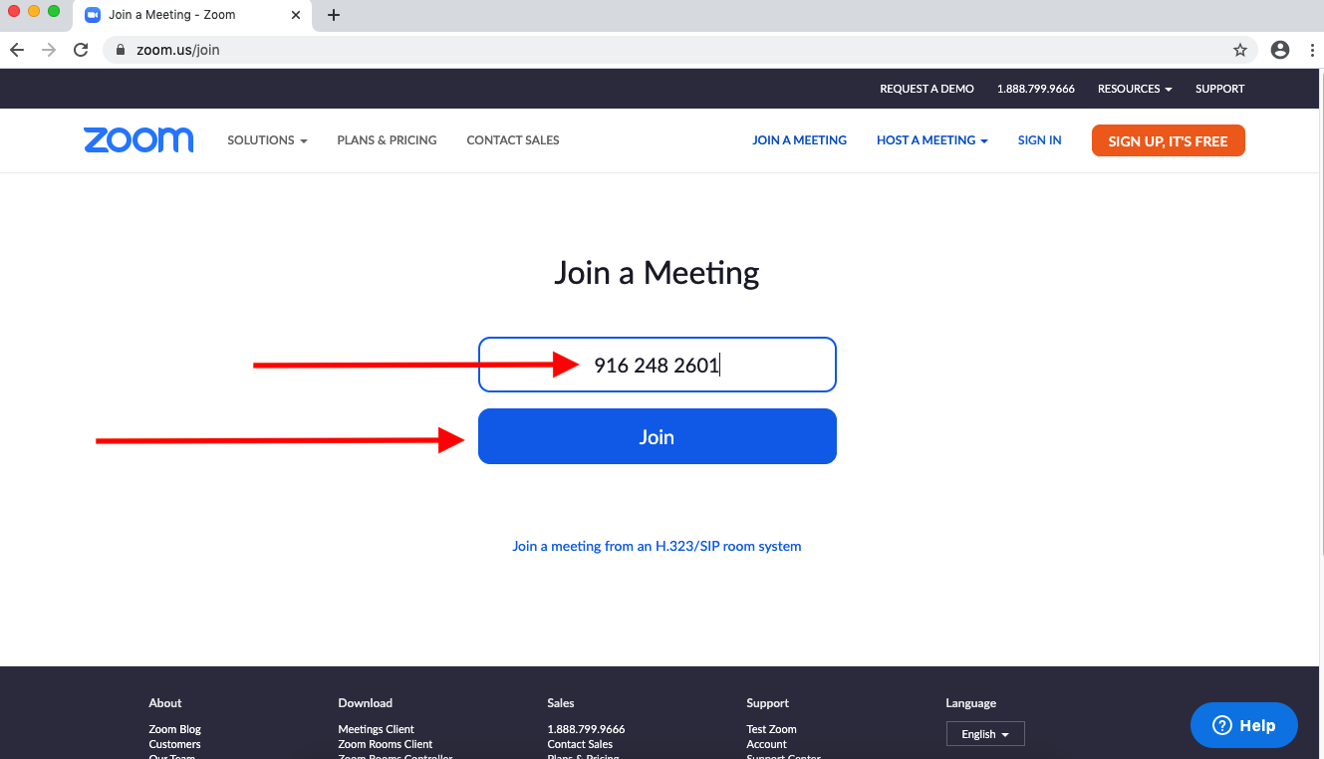
Type in the meeting ID: 916 248 2601 Click “Join”

Slide 5
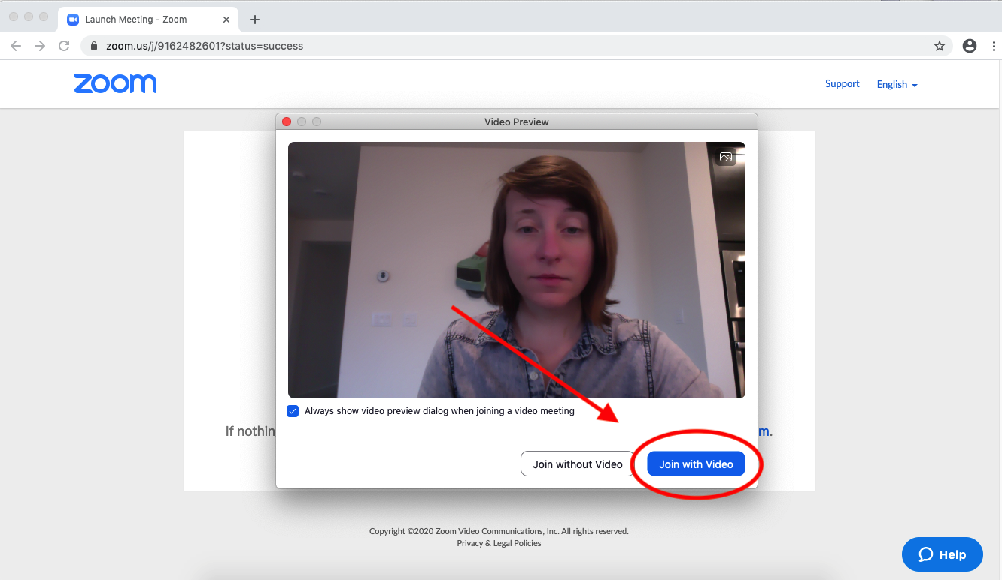
Click on “Join with Video”

Slide 6
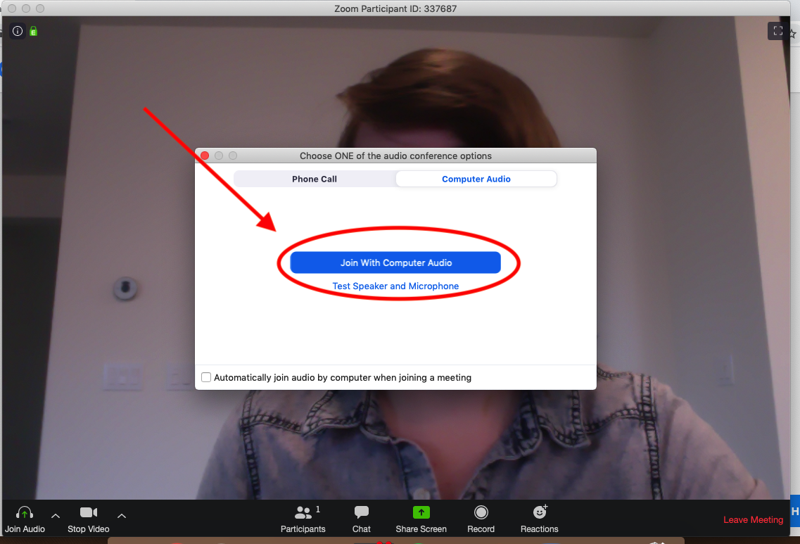
Click on “Join with Computer Audio”

Slide 7
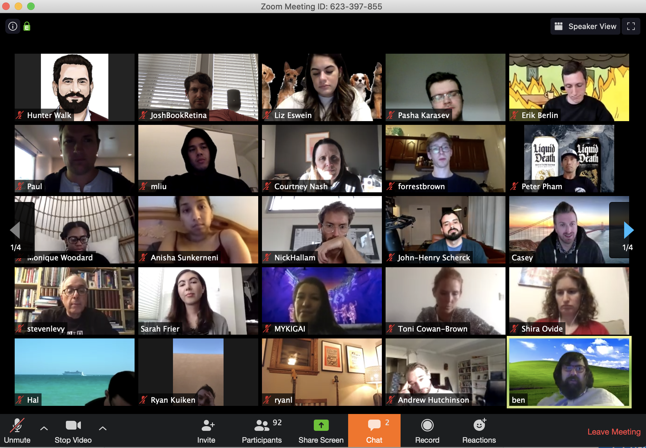
You are in the meeting! People can see and hear you Have fun!

Slide 8
To leave the meeting, click “Leave Meeting” in the bottom right hand corner

