Slide 1
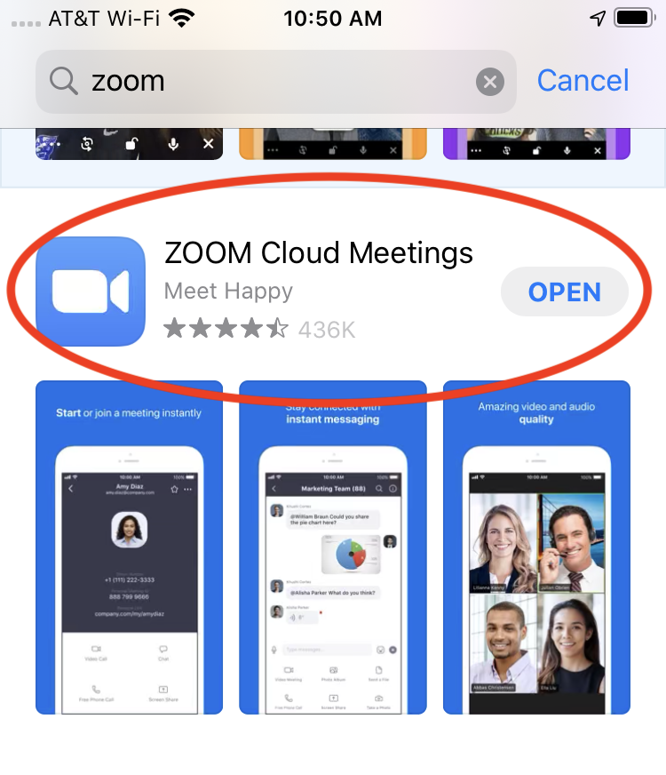
Download the Zoom App

Slide 2
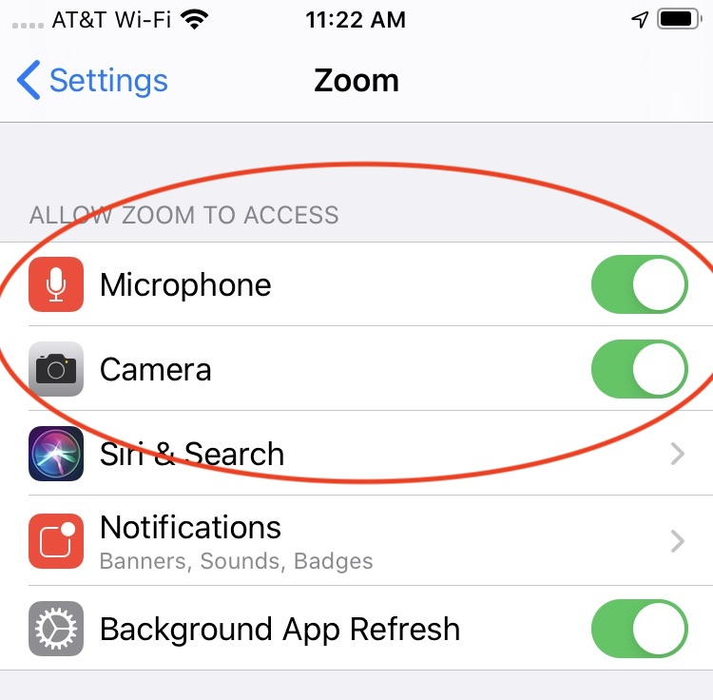
Make sure Zoom has access to your microphone and camera

Slide 3
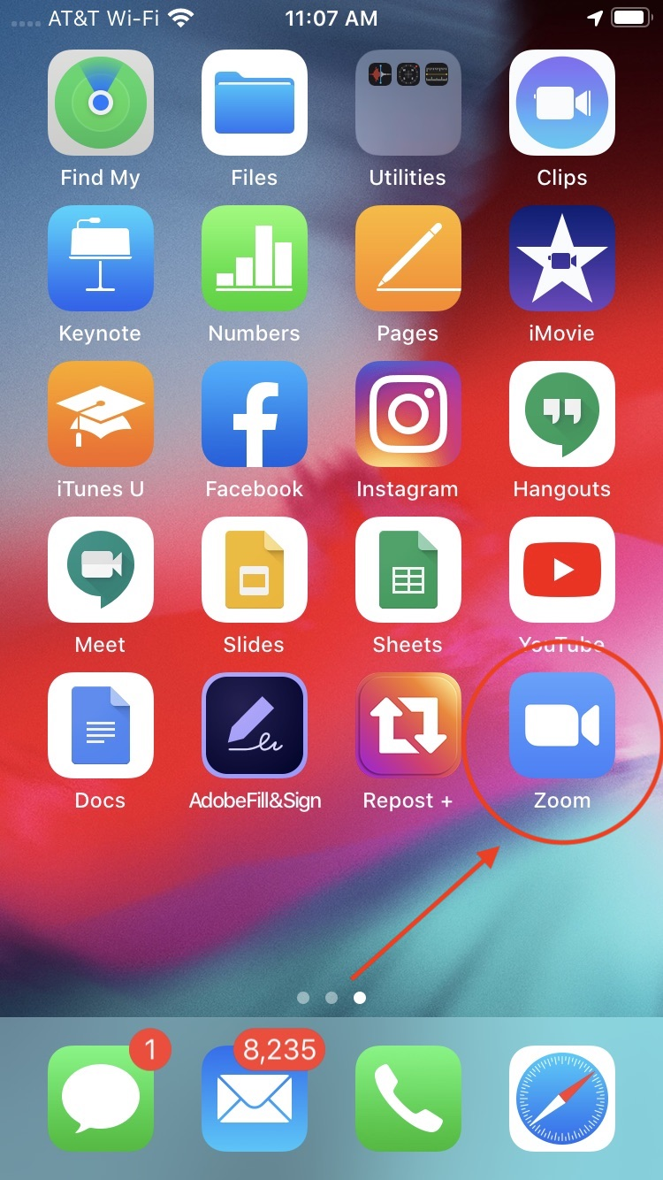
Open the Zoom App

Slide 4
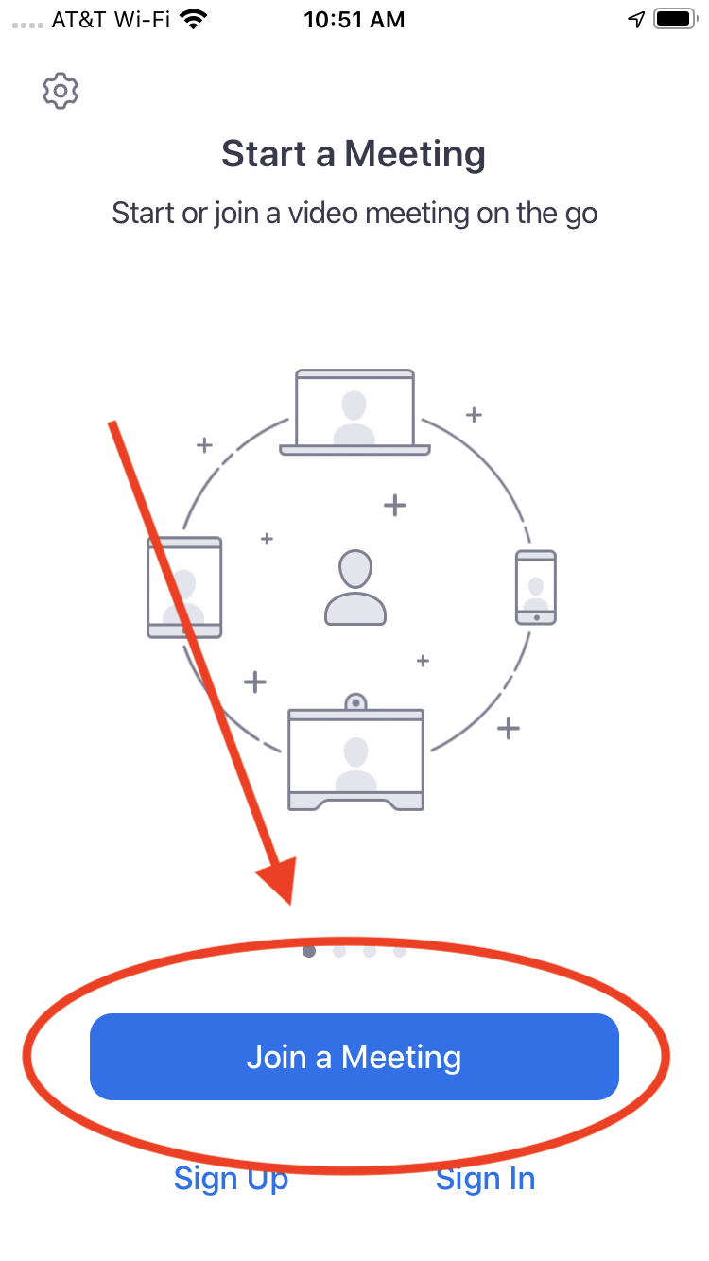
Click the blue “Join a Meeting” button

Slide 5
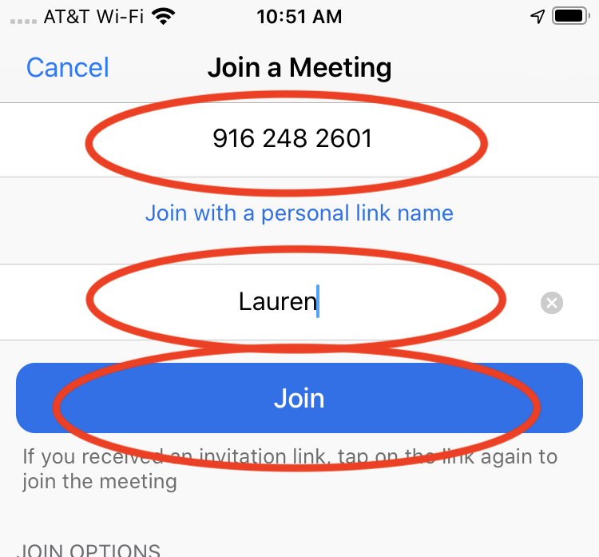
Type in the meeting ID Type in your name Click blue “Join” button

Slide 6
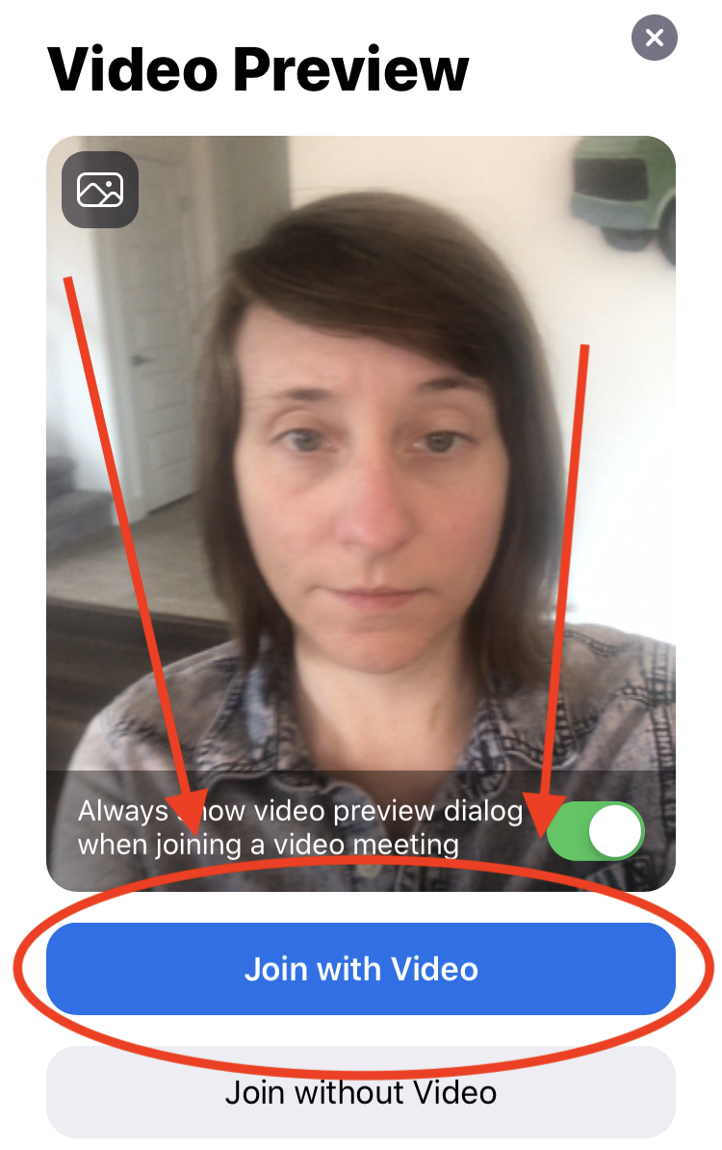
Click on “Join with Video”

Slide 7
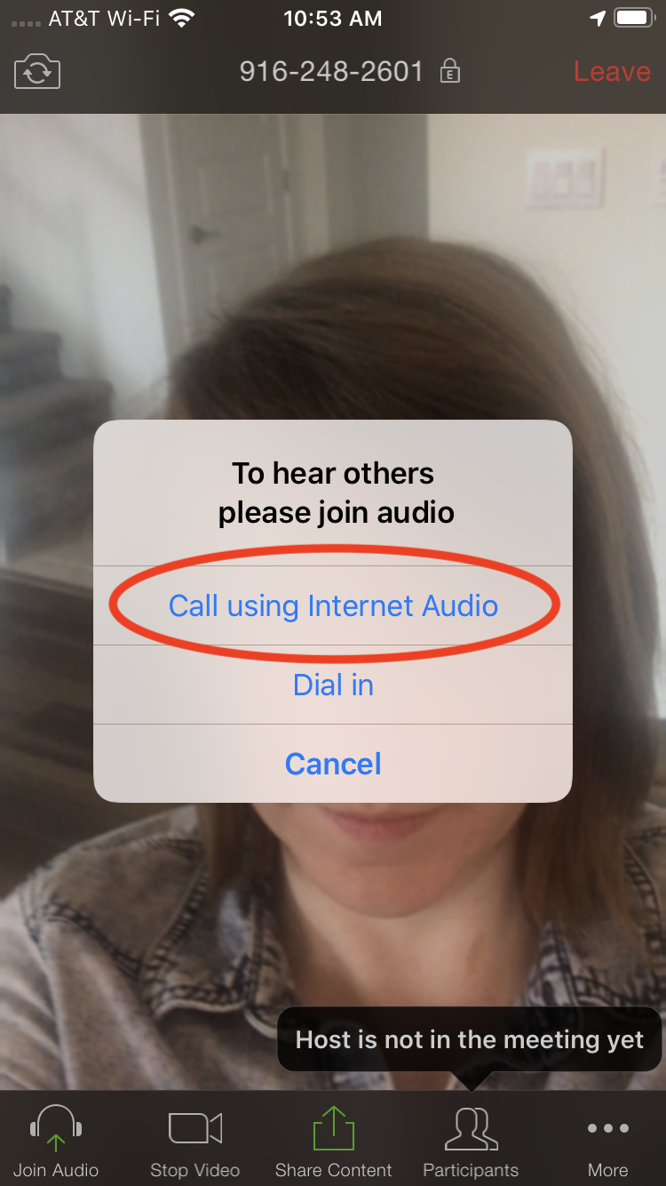
Click on “Call using internet audio”

Slide 8
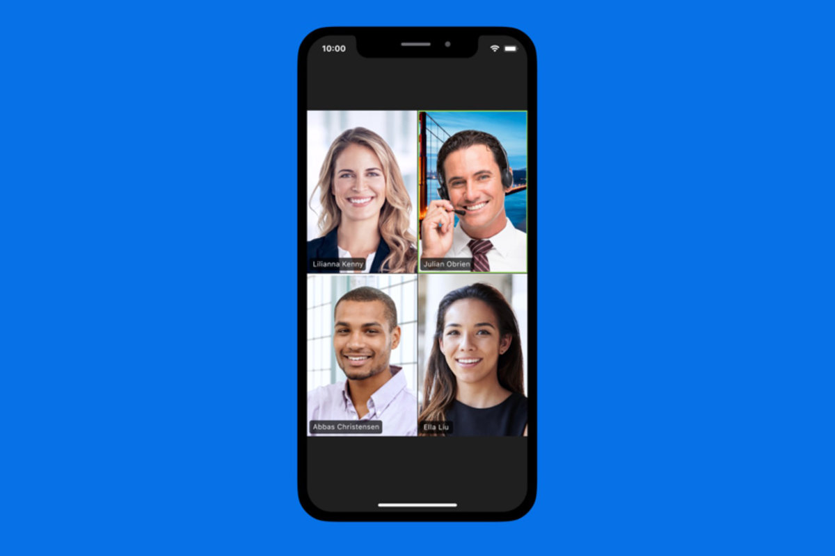
You are in the meeting! People can see and hear you Have fun!

Slide 9
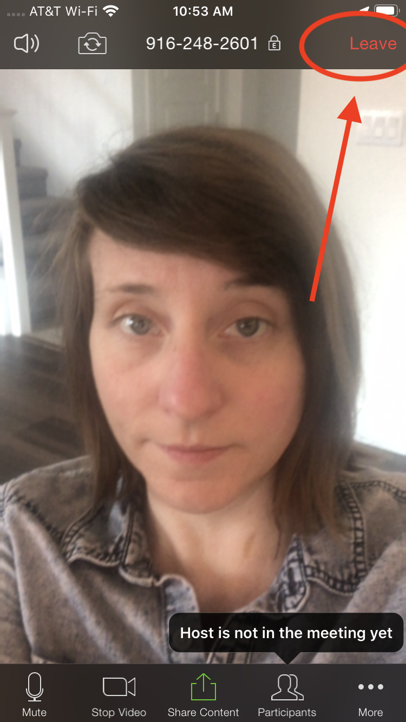
To leave the meeting, click “Leave” in the top right hand corner

