Slide 1
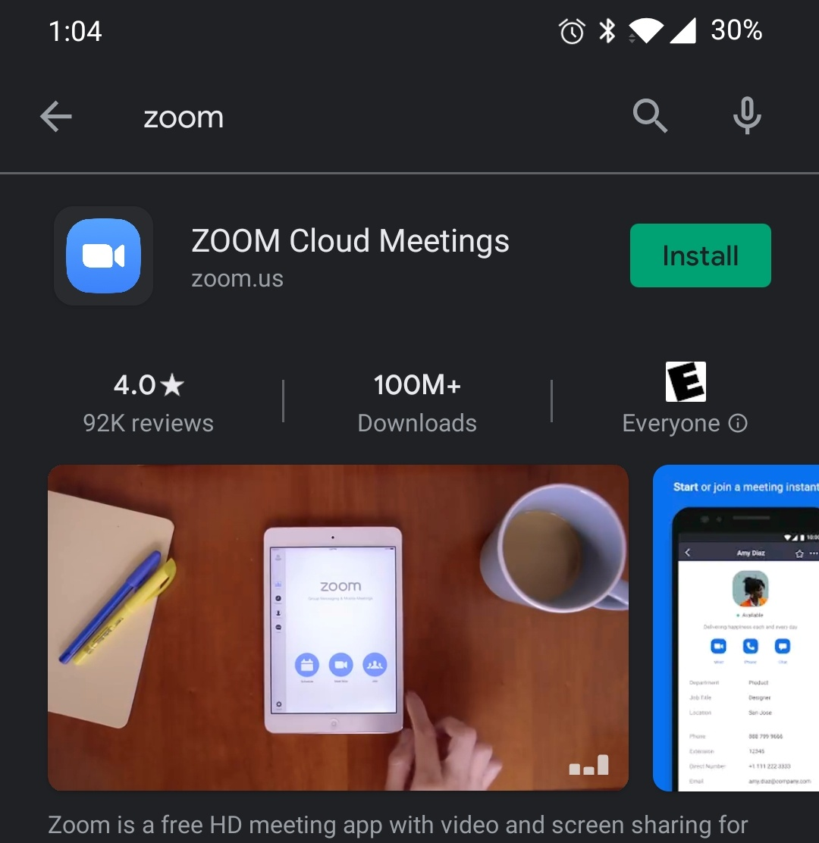
Install the Zoom App and wait for it to download

Slide 2
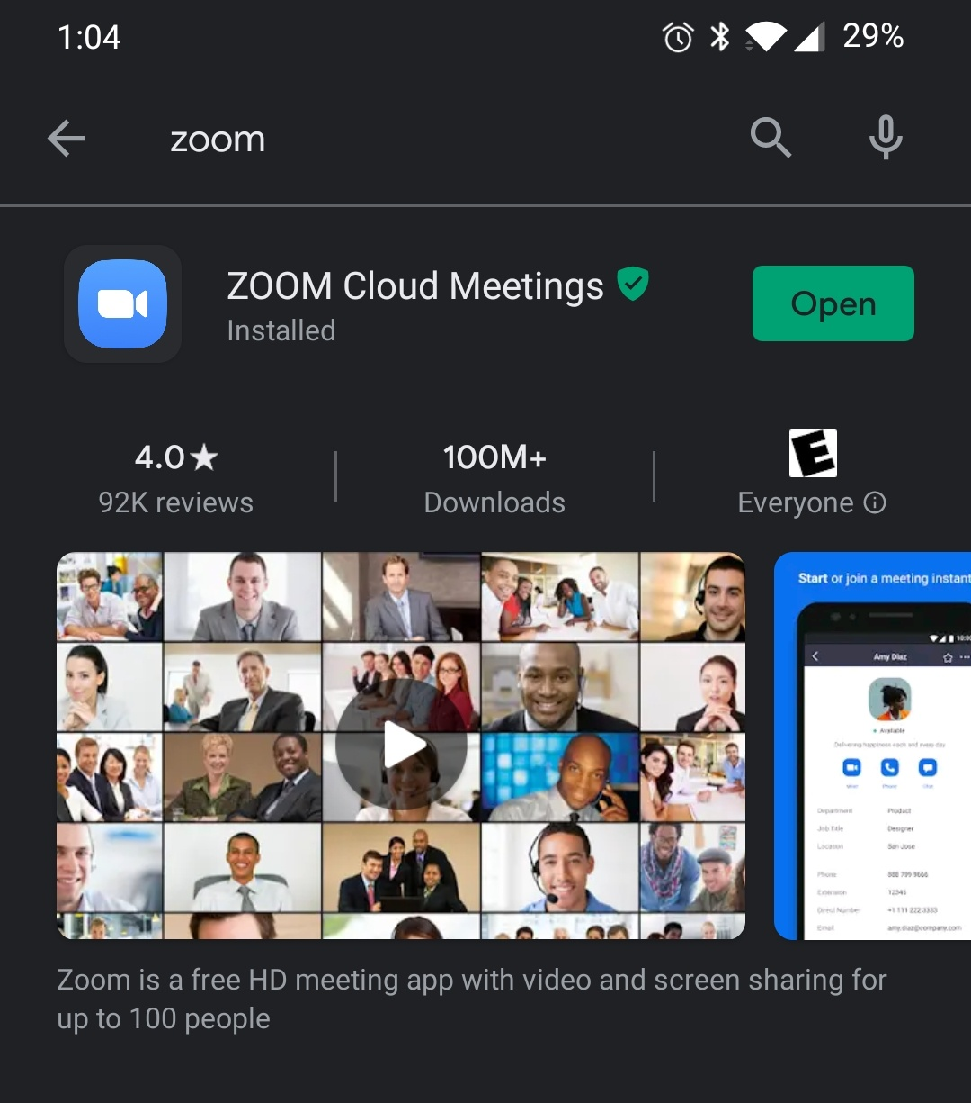
Open the Zoom App

Slide 3
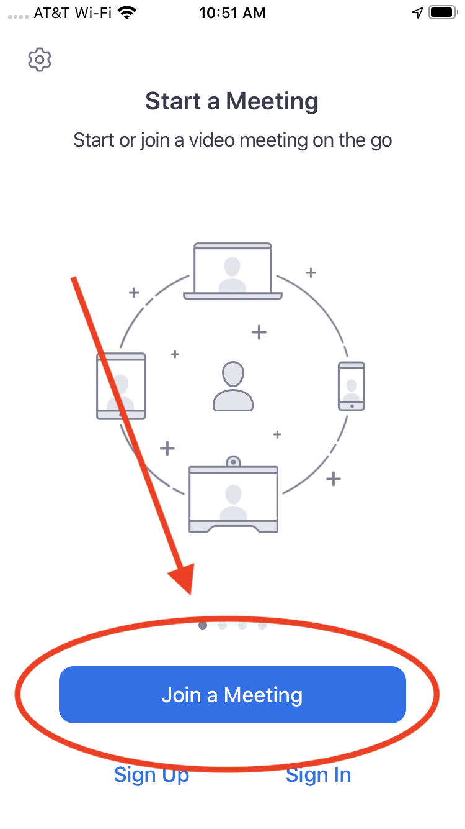
Click the blue “Join a Meeting” button

Slide 4
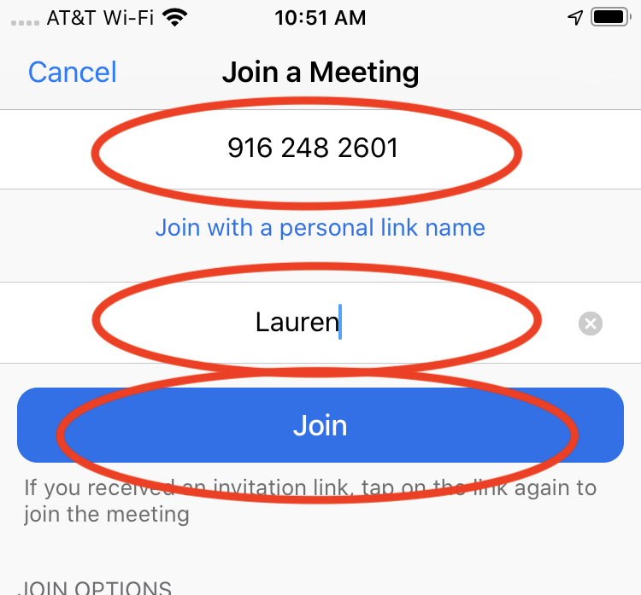
Type in the meeting ID Type in your name Click blue “Join” button

Slide 5
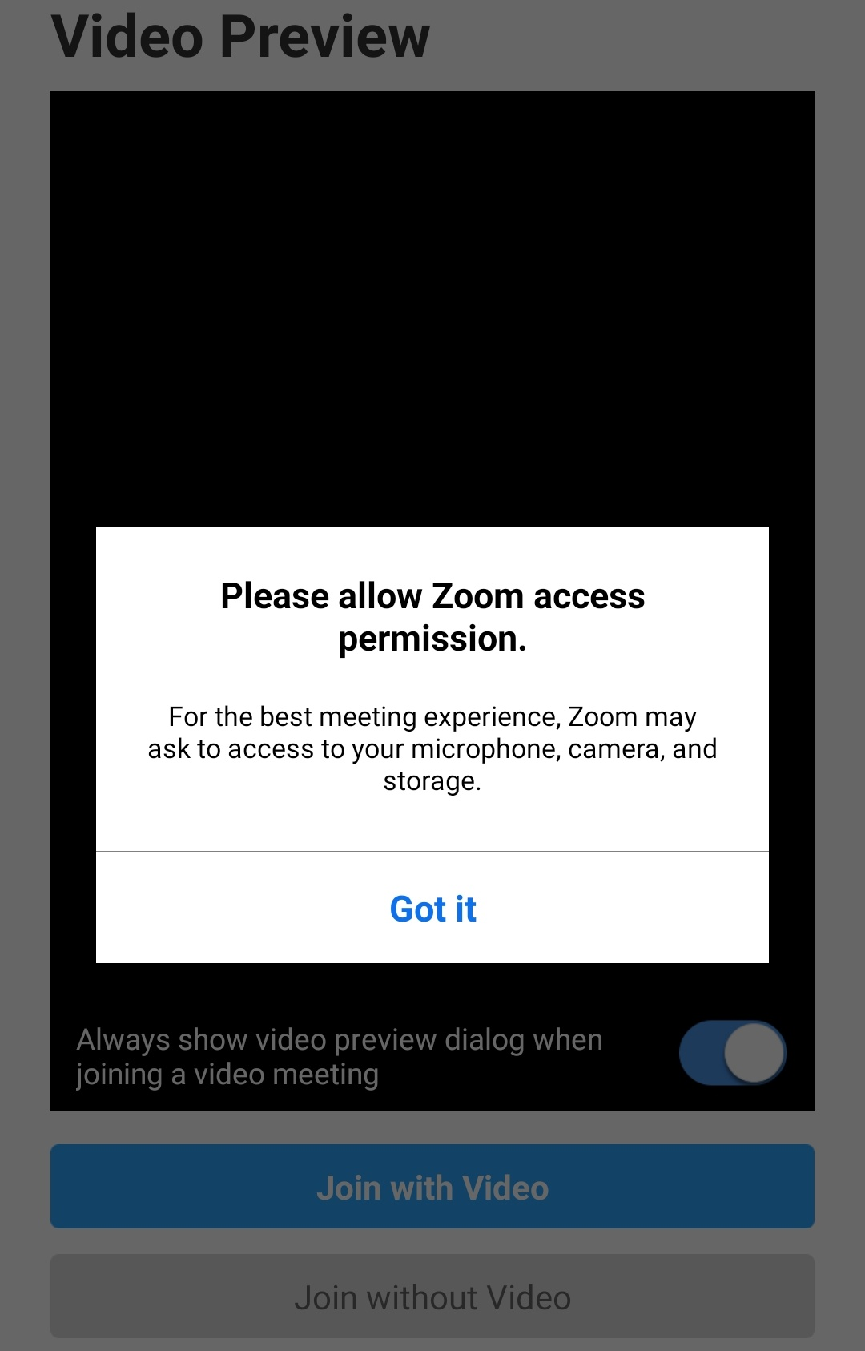
Give Zoom “access permission”

Slide 6
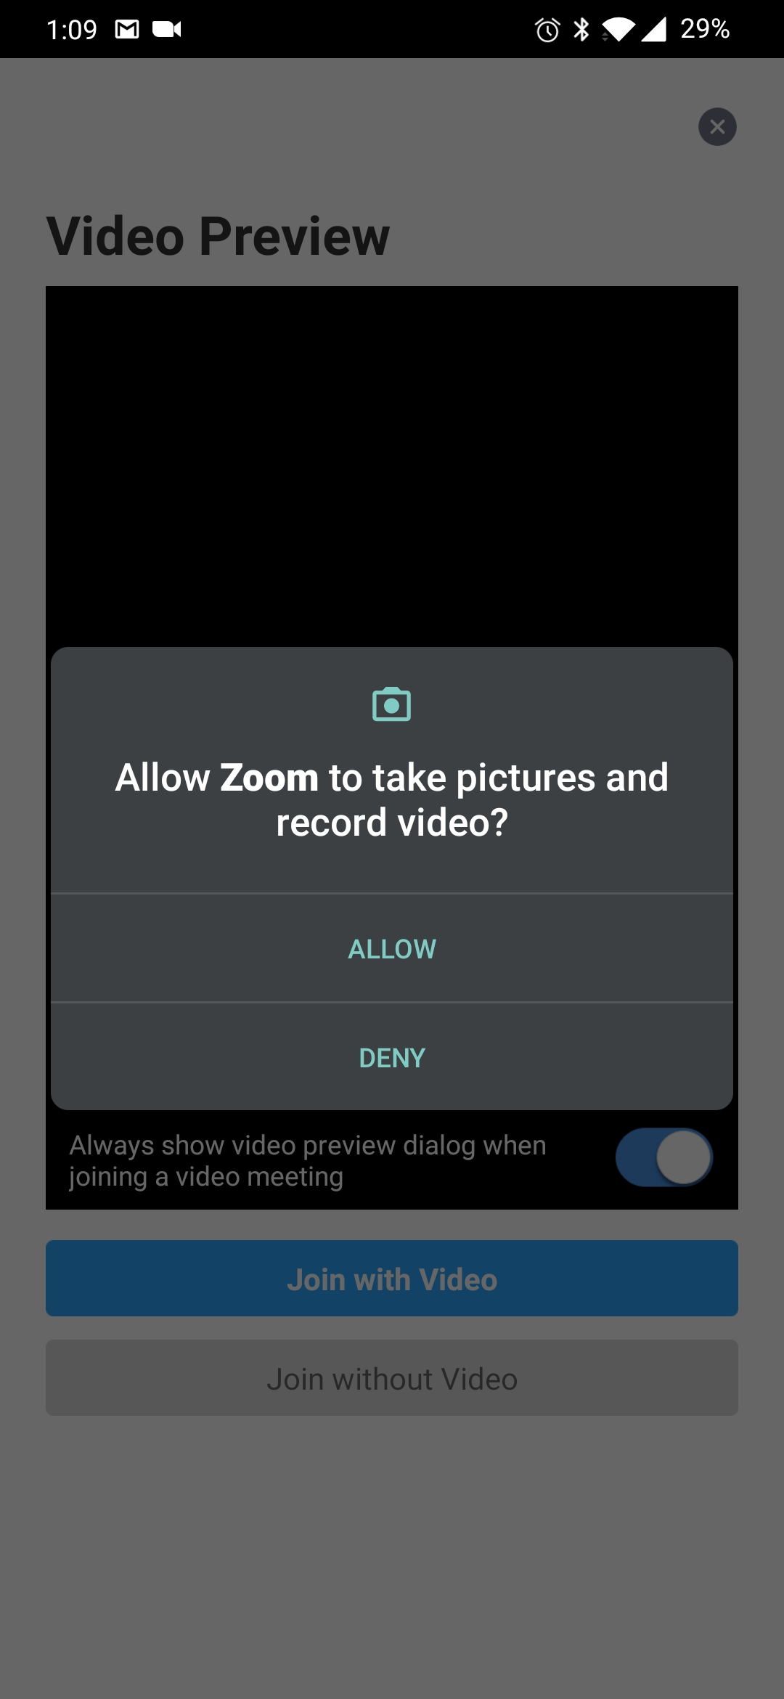
Click on “Allow”

Slide 7
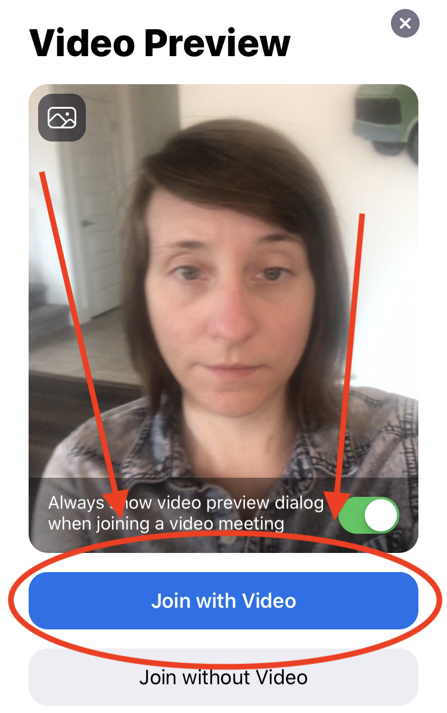
Click on “Join with Video”

Slide 8
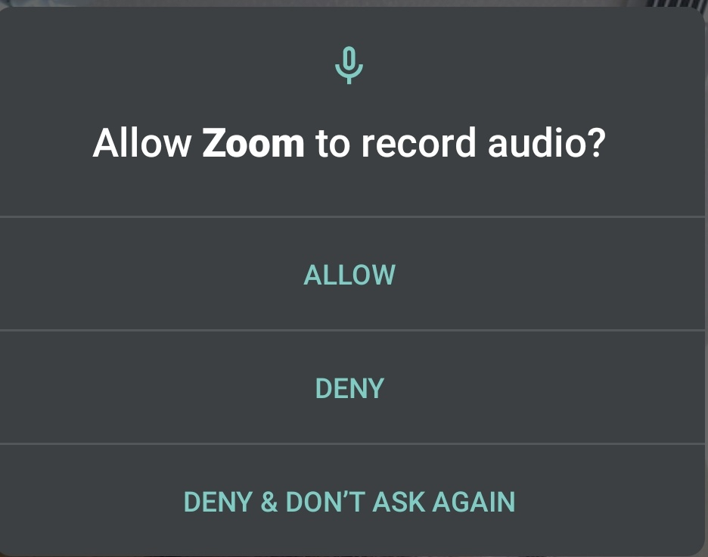
Click on “Allow”

Slide 9
You are in the meeting! People can see and hear you Have fun!

Slide 10
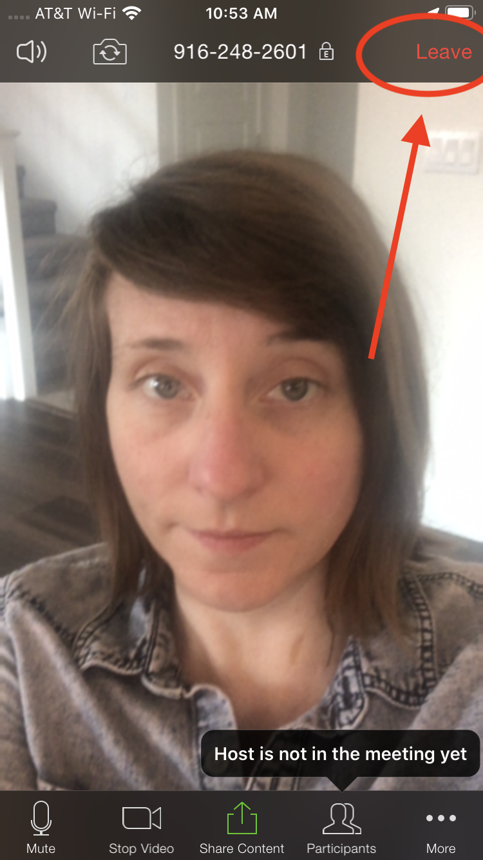
To leave the meeting, click “Leave” in the top right hand corner

